Slide 1
Entrustable Professional Activities for Workplace Learning and Assessment
Workshop on Workplace Learning, EPAs and ePortfolios
South African Association of Family Physicians,
October 11 and 13, Cape Town and Johannesburg, SA
Olle ten Cate, PhD
Utrecht Center for Research and Development of Health Professions Education
University Medical Center Utrecht, the Netherlands

Slide 2
Disclosure
The presenter receives a honorarium from Parantion
This presentation does not imply an endorsement for any specific brand of education technology

Slide 3
Overview
Core principles of CBME and EPAs
How do entrustment decisions come about?
Four components of workplace-based assessment
Capturing ‘assessment for entrustment’ with technology
Tips to develop EPAs and EPA frameworks
EPAs for Family Medicine: one example

Slide 4
What is competency-based education?

Slide 5
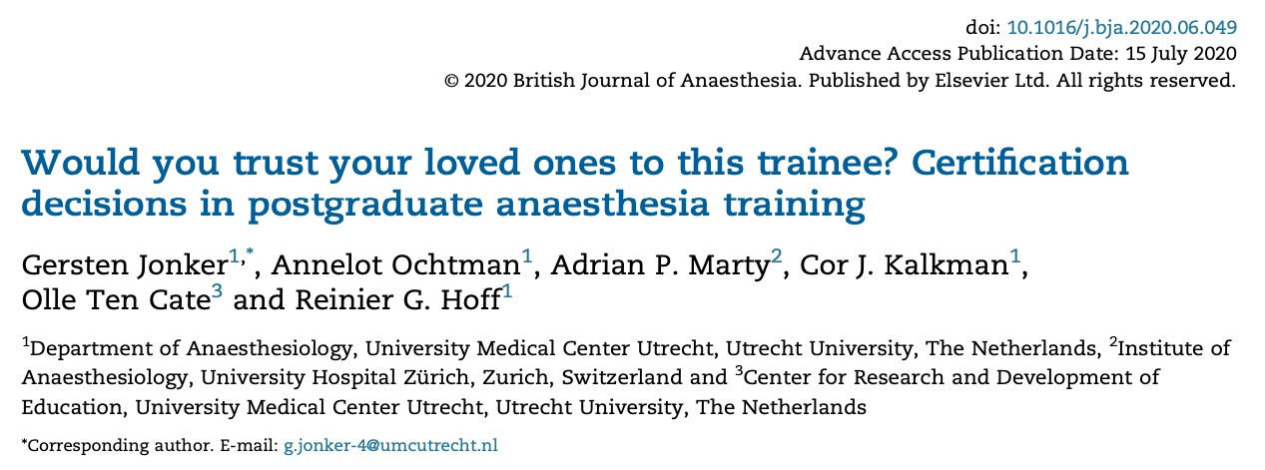


Slide 6
If you have been a program or clerkship director:
Have you ever signed off for completion of a program or rotation, while not fully confident the learner had met critical objectives?

Slide 7

If you have been a program or clerkship director:
Have you ever signed off for completion of a program or rotation, while not fully confident the learner had met critical objectives?
Mentimeter results

Slide 8
Essence of competency-based medical education
CBME: ﻿Education, aimed at a standard level of proficiency for all graduates
Critical features of CBME:
  Clear description of standards for a “good physician/specialist”
  Assessment of all medical trainees using these standards
  Competence, not time, is primary reason to finalize training

Slide 9
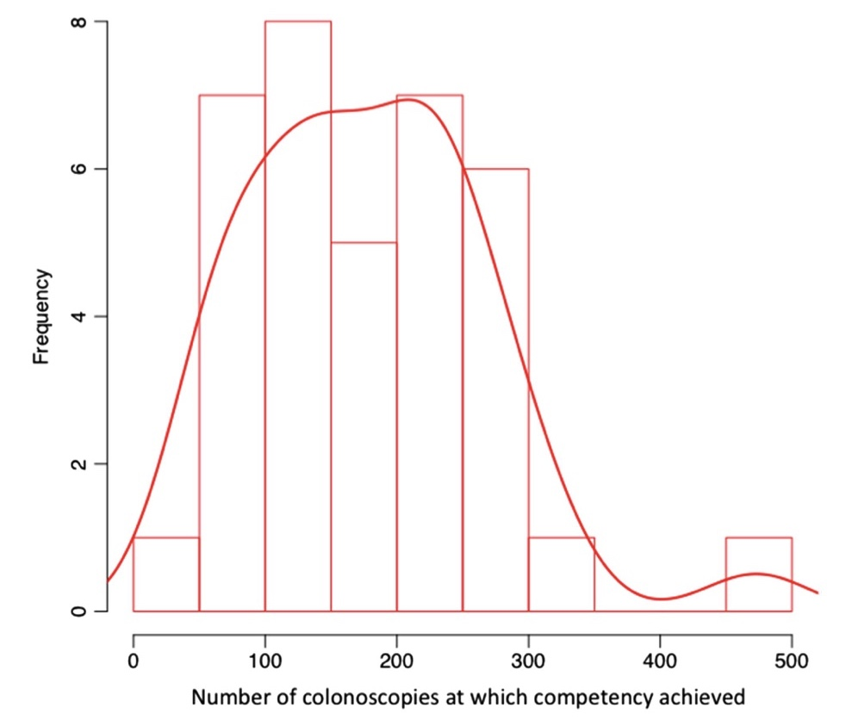
Time-to-competence for safe and high quality performance varies among 35 trainees for the activity (EPA) of colonoscopy
Ward et al 2014, GUT

Slide 10


Competency frameworks
Competencies must prepare learners for the work of health care
Competency frameworks: accepted worldwide, but risk to become detailed, abstract, and difficult for workplace-based assessment
EPA refocus the attention to concrete health care activities

Slide 11
Entrustable Professional Activity (EPA)
Definition: Unit of professional practice (a task or responsibility) that can be fully entrusted to a trainee, once he or she has demonstrated the necessary competence to execute this activity unsupervised
Purpose: To operationalize competency-based medical education through a stepwise and safe engagement of trainees in clinical practice – with a progressive autonomy
Applicability: Created for PGME, now used in all health professions

Slide 12
EPAs require the integration of multiple competencies
EPA1
EPA2
EPA3
EPA4
EPA5
Medical expert
++
++
+
++
Collaborator
+
+
++
Communicator
+
++
+
Leader
+
++
++
Health advocate
+
++
+
Scholar
+
++
Professional
+
+
+
Recommendation: focus assessment on EPAs; use competencies for feedback

Slide 13

Does it fit?
Person with competencies
Task (EPA)
to be done

Slide 14

Operationally defining ‘competent’
When a professional activity is mastered..
…at a threshold level
...that permits trust
...to act unsupervised
Competent: stage in a developmental continuum

Slide 15
Growth of competence over time
expert
proficient
competent
advanced
novice
Ready for unsupervised practice
training
deliberate professional practice
Dreyfus & Dreyfus 1986; ten Cate et al, 2010

Slide 16
Competency curves of one trainee for various EPAs
EPA2
EPA4
EPA3
EPA1
Compe-
tence
thres-
hold
EPA5
Loss of trust
Justified entrustment decisions
training
deliberate professional practice
Notes:
16
16
16

Slide 17
An individualized workplace curriculum
 | Graded supervision allows for
1 | Observing the activity
2 | Acting with direct, pro-active supervision present in the room
3 | Acting with (re-active) supervision available within minutes
4 | Acting unsupervised, i.e. under clinical oversight
5 | Acting as the supervisor to a junior
Portfolio of: trainee Jones | PGY1 |  | PGY2 |  | PGY3 |  | PGY4
EPA a | 1 | 2 | 2 | 2 | 3 | 4 | 4 | 5
EPA b | 1 | 1 | 2 | 2 | 2 | 3 | 3 | 4
EPA c | 2 | 2 | 3 | 4 | 5 | 5 | 5 | 5
EPA d | 2 | 3 | 4 | 4 | 4 | 4 | 5 | 5

Slide 18


Step-wise, legitimate participation in health care
From primarily educational environment
Step by step, EPA by EPA
Observe only
Act with direct supervision
Act with indirect supervision
Act unsupervised
From the periphery to the center of a community of practice
to primarily professional
community
1
2
3
4

Slide 19
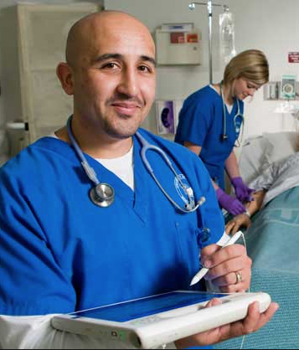
The purpose of workplace-based assessment: Retrospective or Prospective?
Does the student show mastery of the content, taught in courses and rotations?
Is the student ready to assume the expected future responsibilities?
End of
training

Slide 20
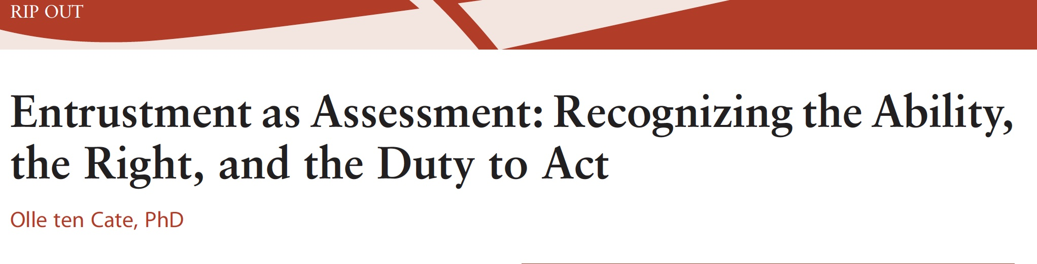
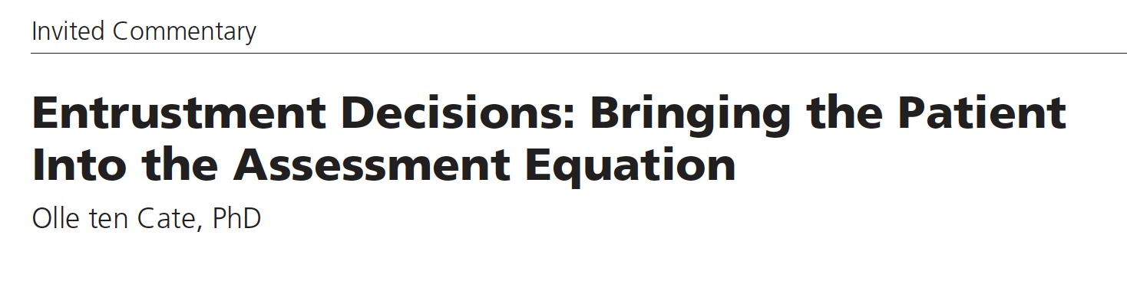
Journal of Graduate Medical Education, 2013
Academic Medicine, 2017

Slide 21

Psychology of traditional workplace assessment
Please… mark me ‘superior’
She’s nice and works hard; it
won’t hurt and will probably motivate
her if I mark her ‘superior’

Slide 22
Psychology of EPA-based workplace assessment
Please… mark me ‘superior’
She’s nice and
works hard, but can
I trust her with this EPA? It may hurt my
patients if I mark
her ‘ready for unsupervised
practice’….

Slide 23
The trust concept in EPA-based assessment
Trusting someone is making yourself vulnerable
Accepting the risk that adverse events could happen
Graduates will be certified for activities supervisors may not have observed and leaners may not have encountered
Entrustment decisions require estimation of adaptive competence to cope with unfamiliar situations
Trust involves more than an average of past performances

Slide 24
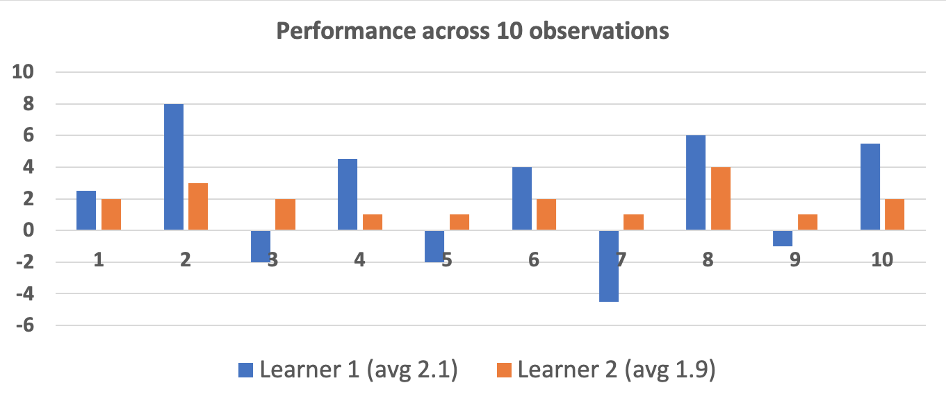
Who would you trust most for the next patient?

Slide 25
Is reporting what a learner ‘does’ really the highest level of assessment we should aspire?
Estimated readiness for
future demands
Trusted
KSA integrated and observed in context
Does
Integrated
knowledge & skill
Shows how
Applied knowledge
Knows how
Knows
Knowledge
Academic Medicine, 2021

Slide 26
What factors determine entrustment decisions?
“Can I trust this student to attend to this patient now?”
Ad-hoc entrustment decision
More than knowledge, skill or specific proficiency

Slide 27
Integrity
Reliability
Humility
Capability
Agency
Learning
need
Clinical
experience
Clinical ability
Trust propensity
Supervisory
experience
“Can I trust this student to attend to this patient now?”
Trainee
Supervisor
Ad-hoc entrustment decision
Qualified personnel
around
Time of
the day
Need for
hands
Difficulty
of the
task
Risks involved
Context
Task
Supervisor-
Trainee relationship
Like-mindedness
Duration of acquaintance
Interpersonal culture

Slide 28
General qualities that enable trust in trainees in HP
Capability (knowledge & skill; experience; adaptive expertise)
Integrity (truthful, good intentions, patient-centered)
Reliability (conscientious, predictable, accountable, responsible)
Humility (observing limits, willing to ask help, receptive to feedback)
Agency (self-confident, proactive toward work, team, safety, development)
Useful acronym: think of A RICH entrustment decision
Based (not exclusively) on: Kennedy et al 2008; Dijksterhuis et al 2009; Sterkenburg et al 2010; Ginsburg et al 2010; Wijnen-Meijer et al 2013 (2x); Choo et al 2014; Tiyyagura et al 2014; Hauer et al 2014; Sheu et al 2016, 2017; Duijn et al 2018. See: ten Cate & Chen 2020

Slide 29

Ad hoc and
summative decisions
Ad-hoc decisions of entrustment are individual decisions, occurring daily in clinical education. Low stakes.
Summative decisions of entrustment are team decisions, based on multiple workplace-based assessments and must lead to increased autonomy (sometimes called a STAR). High stakes.

Slide 31
 | PGY1 |  | PGY2 |  | PGY3 |  | PGY4
EPA a | 1 | 2 | 2 | 2 | 3 | 4 | 4 | 5
EPA b | 1 | 1 | 2 | 2 | 2 | 3 | 3 | 4
EPA c | 2 | 2 | 3 | 4 | 5 | 5 | 5 | 5
EPA d | 2 | 3 | 4 | 4 | 4 | 4 | 5 | 5
Ad hoc decision + evaluation
EPA
Ad hoc decision + evaluation
Ad hoc decision + evaluation
EPA
Diploma /
Degree /
License /
Certification
Ad hoc decision + evaluation
EPA
Ad hoc decision + evaluation
EPA
Ad hoc decision + evaluation
EPA
Ad hoc decision + evaluation
Ad hoc decision + evaluation

Slide 32
Assessment and entrustment: building a validity argument
traditional assessment in education
entrustment decision making
observation
judgment about task execution
inference about competence
inference about readi- ness for automomy
(summative) decision to entrust
Kane’s va-lidity steps:
scoring
inference
generalization
inference
extrapolation
inference
implication
inference

Slide 33
EPAs break down license and specialty registration
License after medical school and registration after postgraduate training are broad ‘entrustment decisions’
Often based on assumptions of skill acquisition through X years of training, supplemented with a knowledge exam
Often more a leap of faith than based on grounded trust
Breaking down license and specialty certificate into ‘units of practice’ that can be overseen, monitored, assessed and docu-mented allows for better grip on individual performance

Slide 34



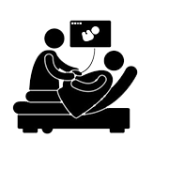
Workplace-Based Assessment
Four critical information sources
1. Direct, brief observations | 2. Longitudinal observations | 3. Case-based discussions | 4. Product evaluation
Recommendation: include elements of all four

Slide 35

1. Brief, direct, observation
Direct or video observation:
  Bedside (MiniCEX)
  Consultation room
  Procedure (DOPS, OSATS)
  Morning rounds
  Handovers
  Any other brief situation in clinical practice

Slide 36
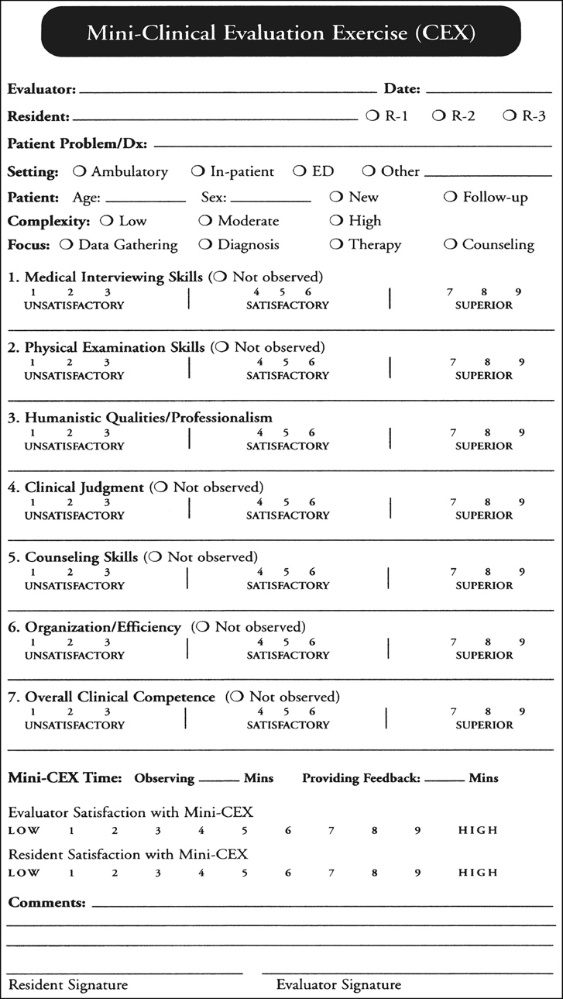

Recommended flow in direct observation
Supervisor asks student for goal
Student designs learning plan
Learner identifies learning
goal
After,
supervisor and student analyze for further
goals
Supervisor observes, gives real-time feedback
Kogan et al. 2017

Slide 37
2. Longitudinal Observation
Usually multi-source evaluations
Clinicians, nurses, other health professionals, peers, junior learners, patients
Focus on general professionalism features for entrustment (agency, reliability, integrity, humility)
Recommended procedures:
Agreed-upon period (shift, week, rotation)
Observations unplanned / not scheduled
Observers may be chosen by trainee
Anonymized reporting
Narrative feedback better than scores
Use MSF report for facilitated feedback & action plan

Slide 38
Suitability of competency domains for MSF
CanMEDS roles | I. Medical colleagues | II. Non-medical colleagues | III. Patients
Medical Expert
Communicator
Professional
Manager/leader
Collaborator
Scholar
Health advocate
Suitable |  | Not so suitable

Slide 39
Example: Flow of the web based Utrecht MSF procedure*
Program director sets evaluation date and resident email address to start U-MSF
Resident receives email:
1. instructions and link to website
2. username & password
After asking raters for consent, resident pro-vides email addresses to U-MSF
PD evaluates MSF results with resident
PD can view MSF progress, can open completed questionnaires
Resident can view MSF progress (not scores), invite new raters, send reminders
Summary feedback report: mean scores & narrative comments; sent to PD & resident
Raters receive email with instructions and link to open and fill out questionnaire
Automatic & anonymous processing of results
*national tool, operated 2008-2018

Slide 40
3. Case-based discussions and oral exams
Purpose is not: providing feedback, but: testing knowledge, insight, and anticipated action
CBD (British) ~ Chart-Stimulated Recall or CSR (American): is a conversation based on data in patient record to probe for clinical reasoning
EBD = entrustment based discussion: conversation
about action, with ‘what if?’ questions, to assess
risks when considering entrustment

Slide 41

Specific CBD: Entrustment-Based Discussion
To evaluate risks before summative entrustment
10-15 min oral discussion, after a (critical) activity
Questions
What have you done? (1’)
Probe for background knowledge and understanding (2’) (anatomy, physiology, tests, treatment)
Awareness of risks and potential complications (3’)
What would you have done if.. ? (4’) .. things had been different (unexpected patient, culture, medical history, lab or other findings, (lack of) cooperation, mental, physical abnormality, multimorbidity, etc)?

Slide 42
4. Product Evaluation
Clinical documentation
Logs of experience, every time a patient is seen (e.g. Clinical Encounter Cards)
Entries into electronic health record
Transfer / discharge summaries
Written reports
  Clinical, Research, Policy, M&M, etc.
  Presentation slides (In writing / poster)

Slide 43
4. Product Evaluation
Clinical products, if applicable, e.g.
  Surgical, orthopedic, dental reconstructions
  Radiological or ultrasound images made
  Patient experience
Presentations (observed)
  Critically appraised topics and other EBM products
  Research, clinical (local, national, international)
  Prepared teaching sessions for students

Slide 44
Mobile app for workplace-based assessment with EPAs
OBSERVER:
OBSERVER:
Dr John Smith
Dr John Smith
OBSERVER:
Dr John Smith
TRAINEE:
TRAINEE:
TRAINEE:
TRAINEE:
TRAINEE:
TRAINEE:
EPA:
EPA:
TRAINEE:
TRAINEE:
EPA:
TRAINEE:
DATE:
DATE:
TRAINEE:
TRAINEE:
DATE:
TRAINEE:
Based on my observation(s), I suggest for this EPA the trainee may be ready after the
next review to:
2. Act under direct
supervision
3. Act under indirect
supervision
4. Act with only
post-hoc report
5. Supervise juniors
Provide feedback on each of the following domains of competence, relevant to this this EPA
* Medical Expert
* Communicator
* Collaborator
* Scholar
* Leader
* Health advocate
* Professional
COMMUNICATOR
Provide specific feedback. Try to include strengths and aspects that may benefit from improvement.
Or record a feedback message
NO Hesitate YES
SPECIFY
SPECIFY
CONFIRM AND SEND

Slide 45
Twelve tips to develop a framework of EPAs
Build up expertise
Assemble a core team
Establish a clear vision of the purpose of EPAs
Draft preliminary EPAs
Elaborate EPAs
Adopt a framework of supervision
Perform a structured quality check
Use a Delphi approach for refinement and/or consensus
Pilot test EPAs
Attune EPAs to their feasibility in assessment
Map EPAs to existing curriculum
Build a revision plan
Hennus et al, submitted

Slide 46
Elaborating an EPA – the 8 components
1 | Title of the EPA
2 | Specification and limitations
3 | Potential risks in case of failure
4 | Most relevant domains of competence
5 | Required knowledge, skills, attitude and experiences
6 | Information sources to assess progress and ground a summative entrustment decision
7 | Entrustment for which level of supervision at which stage of training?
8 | Expiration date

Slide 47
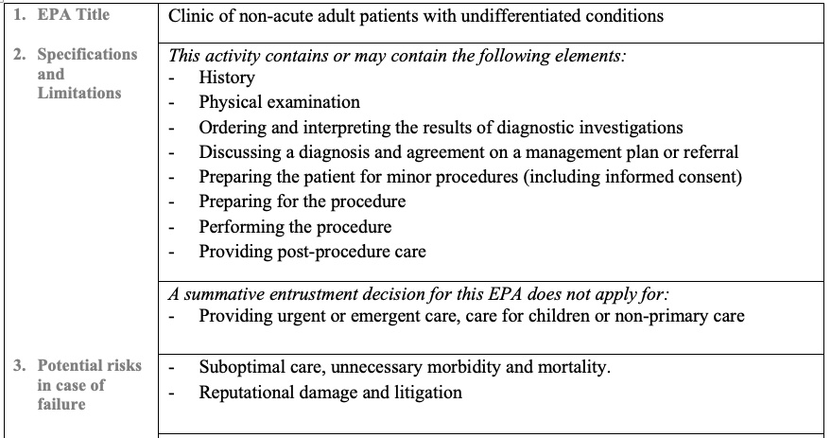
Elaborating one EPA

Slide 48
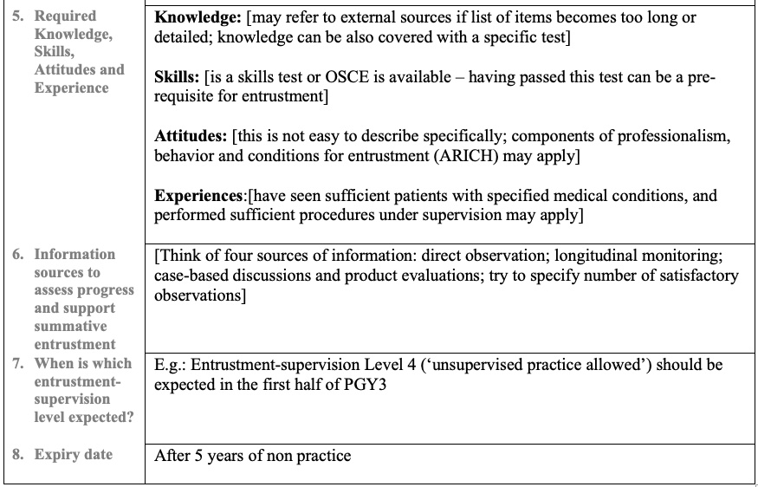
Elaborating one EPA

Slide 49

References
Jonker G, Ochtman A, Marty AP, Kalkman CJ, Ten Cate O, Hoff RG. Would you trust your loved ones to this trainee? Certification decisions in postgraduate anaesthesia training. Br J Anaesth. 2020;125(5):E408–10.
Ward ST, Mohammed MA, Walt R, Valori R, Ismail T, Dunckley P. An analysis of the learning curve to achieve competency at colonoscopy using the JETS database. Gut. 2014;63(11):1746–54.
Swing SR. The ACGME outcome project: Retrospective and prospective. Med Teach. 2007;29(7):648–54.
Frank JR. The CanMEDS 2005 physician competency framework: Better standards, better physicians, better care. Ottawa: Royal College of Physicians and Surgeons in Canada; 2005.
ten Cate O. Entrustability of professional activities and competency-based training. Med Educ 2005;39(12):1176–7.
ten Cate O, Snell L, Carraccio C. Medical competence: The interplay between individual ability and the health care environment. Med Teach. 2010 Jan;32(8):669–75.
Lave J, Wenger E. Situated Learning: Legitimate Peripheral Participation. Cambridge,UK: Cambridge University Press; 1991.
ten Cate O. Entrustment as Assessment: Recognizing the Ability, the Right, and the Duty to Act. J Grad Med Educ. 2016 May;8(2):261–2.
ten Cate O. Entrustment Decisions: Bringing the Patient into the Assessment Equation. Acad Med. 2017;92(6):736–8.
Ten Cate O, Carraccio C, Damodaran A, Gofton W, Hamstra S, Hart D, et al. Entrustment Decision Making: Extending Miller’s Pyramid. Acad Med. 2020;(in press).
ten Cate O, Chen HC. The ingredients of a rich entrustment decision. Med Teach. 2020;42(12):1413–20.
ten Cate O, Chen HC, Hoff RG, Peters H, Bok H, van der Schaaf M. Curriculum development for the workplace using Entrustable Professional Activities (EPAs): AMEE Guide No. 99. Med Teach. 2015;37(11):983–1002.
Touchie C, Kinnear B, Schumacher D, Caretta-Weyer H, Hamstra SJ, Hart D, et al. On the validity of summative entrustment decisions. Med Teach. 2021;43(7):780–7.
Kogan JR, Hatala R, Hauer KE, Holmboe E. Guidelines: The do’s, don’ts and don’t knows of direct observation of clinical skills in medical education. Perspect Med Educ. 2017;6(5):286–305.
Alofs L, Huiskes J, Heineman MJ, Buis C, Horsman M, van der Plank L, et al. User reception of a simple online multisource feedback tool for residents. Perspect Med Educ [Internet]. 2015 Mar;4(2):57–65. Available from: http://dx.doi.org/10.1007/s40037-015-0173-0
ten Cate O, Hoff RG. From case-based to entrustment-based discussions. Clin Teach. 2017;14(6):385–9.
Ten Cate O, Taylor DR. The recommended description of an entrustable professional activity: AMEE Guide No. 140. Med Teach. 2021;43(10):1106–14.

